Slide 1

Module 01 Live Classroom
Presented by Darice Corey-Gilbert

Slide 2

Welcome to the course!
Each new module begins on Mondays.
Initial discussion posts are due on Tuesdays. Replies are due Saturdays.
Module assignments - activities, course projects, and live lecture quizzes are due on Sundays.
Live Lectures/Classrooms will take place on Tuesdays, unless otherwise noted.
12/1/16 Copyright Rasmussen, Inc. Proprietary and Confidential
2

Slide 3
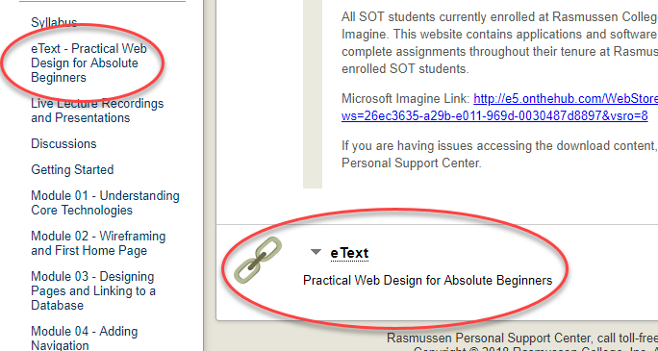
Textbook
I will show basic code during the lectures, but if you feel comfortable with trying out more advanced code used in the text, that is fine as well.
12/1/16 Copyright Rasmussen, Inc. Proprietary and Confidential
3

Slide 4
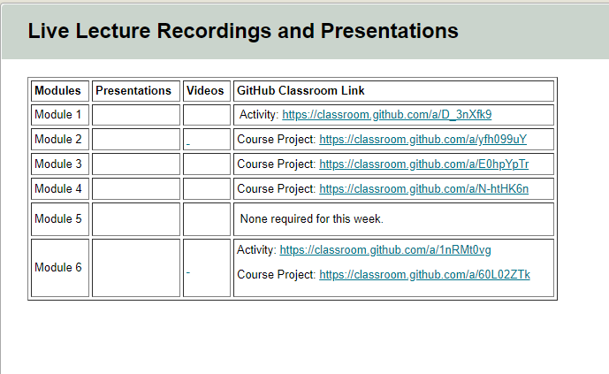
Live Lecture Recordings
Go to “Live Lecture Recordings and Presentations
I will edit the page each week to include links to new presentation and lecture recordings.
GitHub Classroom links are live, so you can click to accept the assignment.
Note: Although we’re using GitHub Classroom to share code, you must still submit assignments in the Course DropBox as instructed with each assignment.
12/1/16 Copyright Rasmussen, Inc. Proprietary and Confidential
4

Slide 5
This week…
Mod 1 Discussion: Best Practices and Poorly Designed Web Apps
1
Mod 1 Activity: Configure Your Dev Environment
2
Mod 1 Course Project: Website Mockup
3

Slide 6
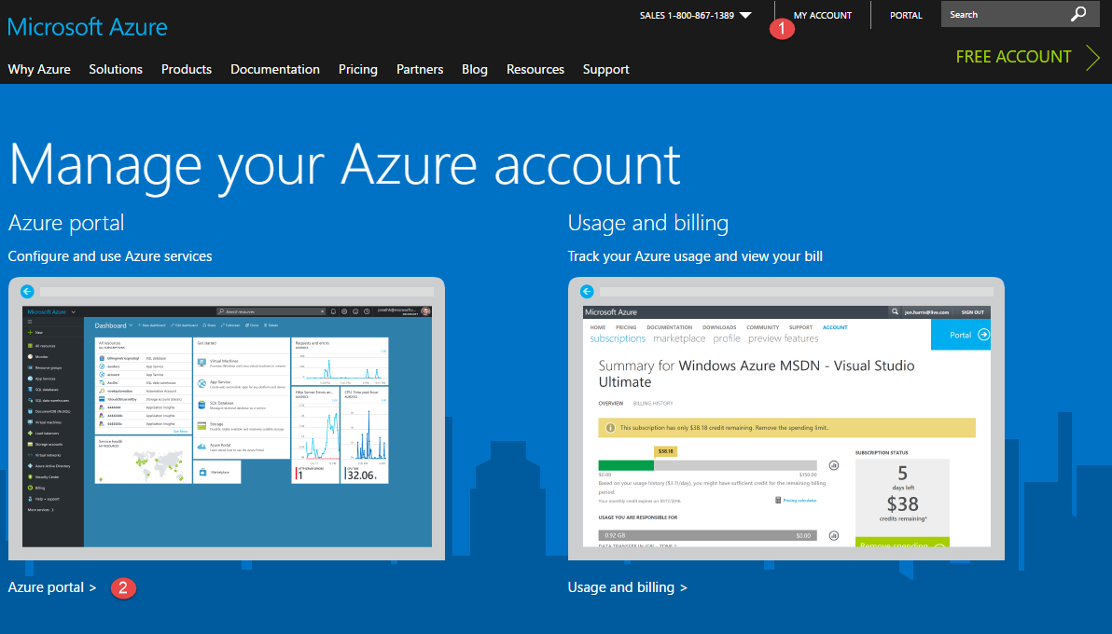
Microsoft Azure
Go to https://portal.azure.com
You should have received your login information via email. If you did not, please let me know ASAP. You will need this to do your assignments.
Your Rasmussen issued login should be something like: [firstname].[lastname]@supersites.onmicrosoft.com
12/1/16 Copyright Rasmussen, Inc. Proprietary and Confidential
6

Slide 7
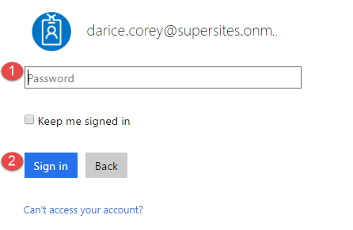
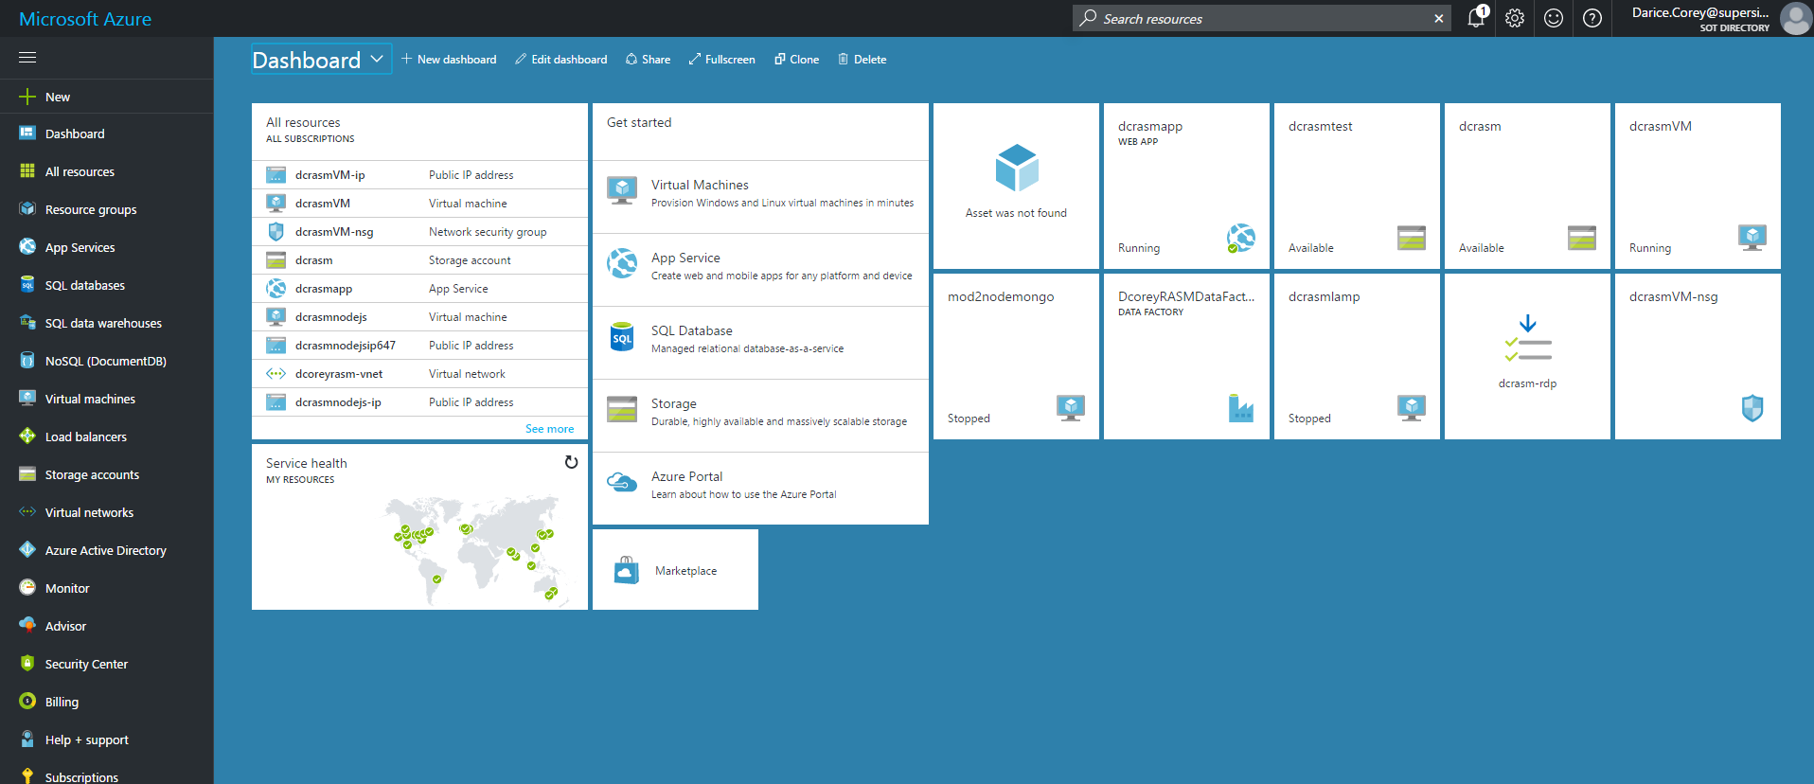
Login
After logging in, you should see your dashboard.
Yours will have fewer items than you see on mine because you haven’t created anything just yet.
12/1/16 Copyright Rasmussen, Inc. Proprietary and Confidential
7

Slide 8
What are we going to do next?
Create a storage account.
Deploy a LAMP virtual server.
Configure the virtual server.
Connect to the virtual server using SSH.
Take screenshots along the way – this way you will have most of the assignment for the Module 1 Activity completed by the end of this lecture!
12/1/16 Copyright Rasmussen, Inc. Proprietary and Confidential
8

Slide 9
Wait…Why are we doing this?!
We will learn about connecting your site to a database later in this course.
PHP (http://php.net/manual/en/intro-whatis.php) is a server-side scripting language.
To run PHP, you need a web server. There are multiple ways to accomplish this (http://php.net/manual/en/tutorial.requirements.php), such as creating a web server on your local machine.
However, for this course, we are going to use Azure to deploy a LAMP.

Slide 10
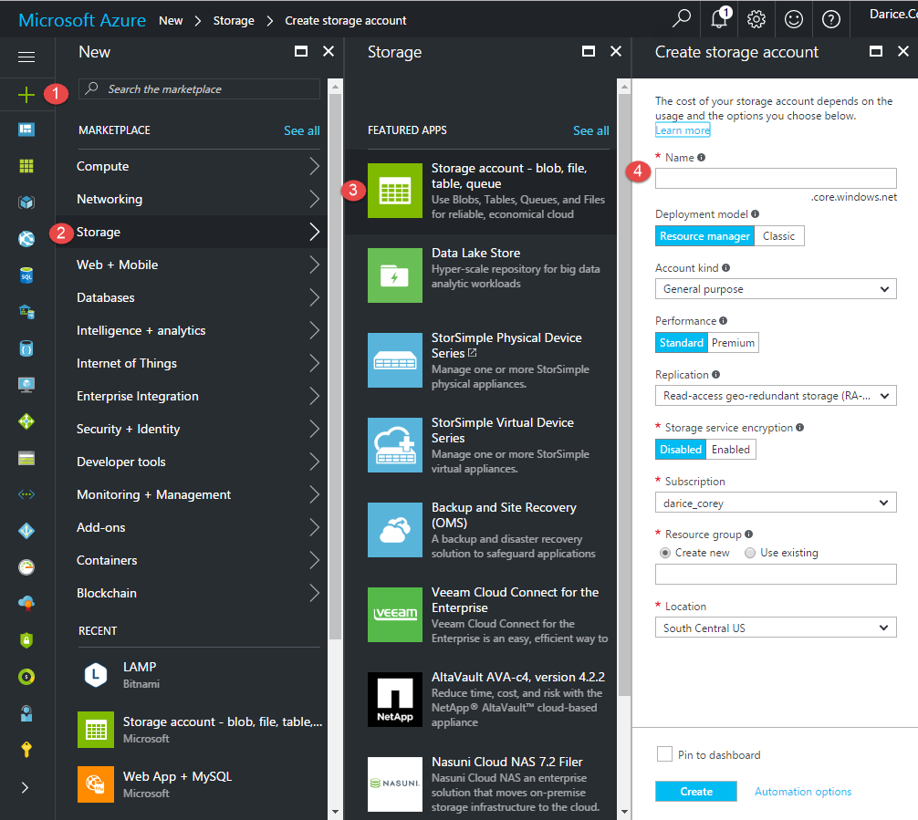
Create a Storage Account
Click +New located at the top left corner of your dashboard above the icons.
A pane titled New opens.
Click on the Storage option or type the word Storage in the filter text box.
A new pane opens titled Storage.
Click on Storage account.
A new pane open titled Create storage account.
Type a Name for the storage account in the Name text box (must be all small case).
12/1/16 Copyright Rasmussen, Inc. Proprietary and Confidential
10

Slide 11
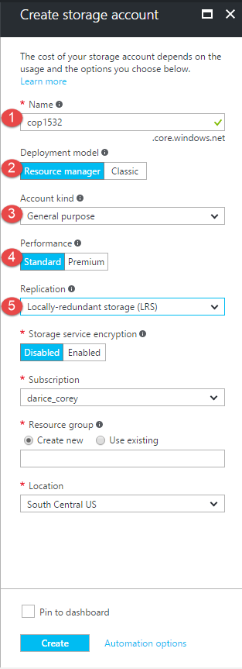
Create a Storage Account
Make sure:
Deployment model is Resource manager.
Account kind is General purpose.
Performance is Standard.
Important: Change Replication to Locally-redundant storage (LRS).
12/1/16 Copyright Rasmussen, Inc. Proprietary and Confidential
11

Slide 12
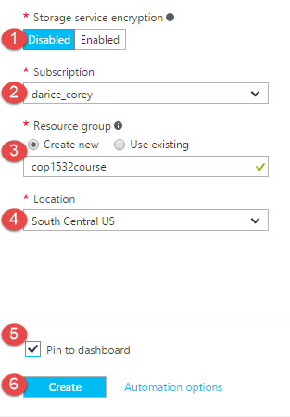
Create a Storage Account
Make sure: Storage service encryption is Disabled.
For Resource group choose the Create new radio button.
Type a unique name in the Resource group text box.
Important: Make sure Location is Central US.
Check the Pin to dashboard option.
Click Create.
12/1/16 Copyright Rasmussen, Inc. Proprietary and Confidential
12

Slide 13
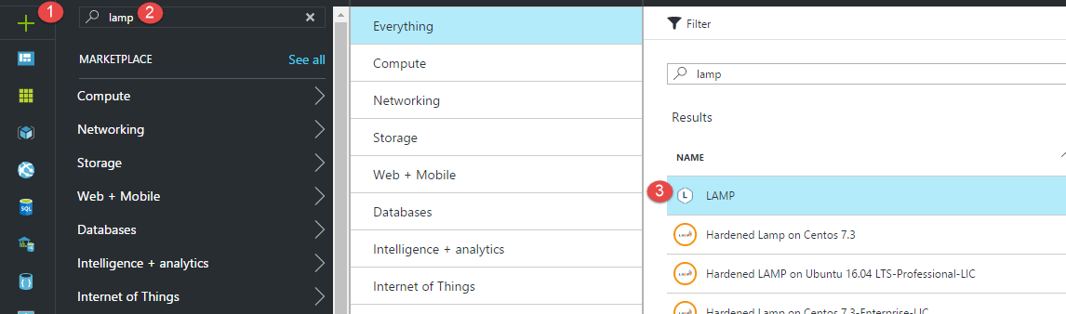
Deploy a LAMP Virtual Server
Click +New located at the top left corner of your dashboard above the icons A pane titled New opens. Click inside the filter text box.
Type “Lamp” and press enter.
A pane titled Everything opens that lists a number of options.
Click on the LAMP by publisher Bitnami option. DO NOT PICK LAMP Multi-Tier.
12/1/16 Copyright Rasmussen, Inc. Proprietary and Confidential
13

Slide 14
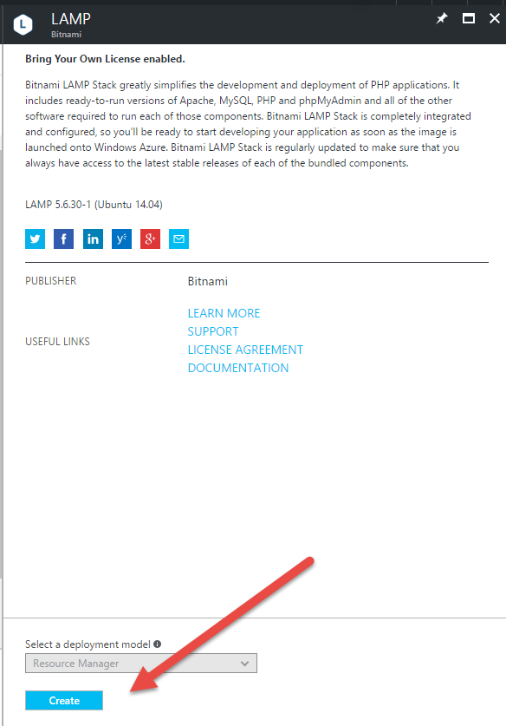
Deploy a LAMP Virtual Server
A pane titled LAMP opens.
Click Create at the bottom of the pane.
12/1/16 Copyright Rasmussen, Inc. Proprietary and Confidential
14

Slide 15
Deploy a LAMP Virtual Server
A pane titled LAMP opens.
Click Create at the bottom of the pane.
12/1/16 Copyright Rasmussen, Inc. Proprietary and Confidential
15

Slide 16
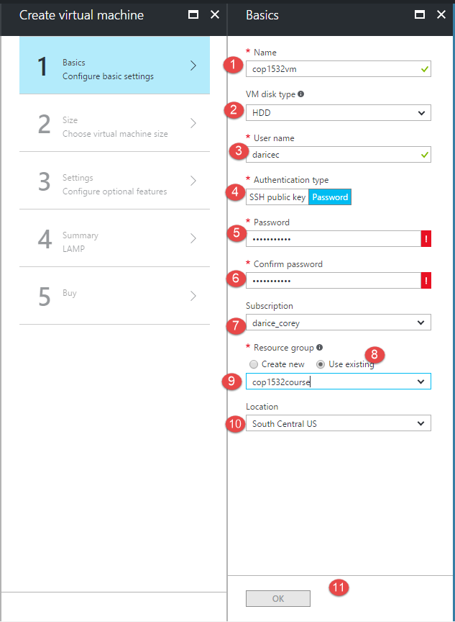
Deploy a LAMP Virtual Server
A Create virtual machine pane opens.
Another pane titled Basics opens.
In the Name text box, type in a unique name for your server. Once you click out of the name text box a green checkmark to the right of the name should appear.
Important: In the choice drop down for VM disk type choose HDD.
Under Authentication type click the Password option button.
Type in an acceptable password in the two text boxes for Password and Confirm password.
Under Resource group choose the Use existing radio button.
Click the dropdown list that appears under Resource group.
Choose the resource group that you created for your storage account.
Important: For Location choose Central US.
Click OK at the very bottom.
12/1/16 Copyright Rasmussen, Inc. Proprietary and Confidential
16

Slide 17
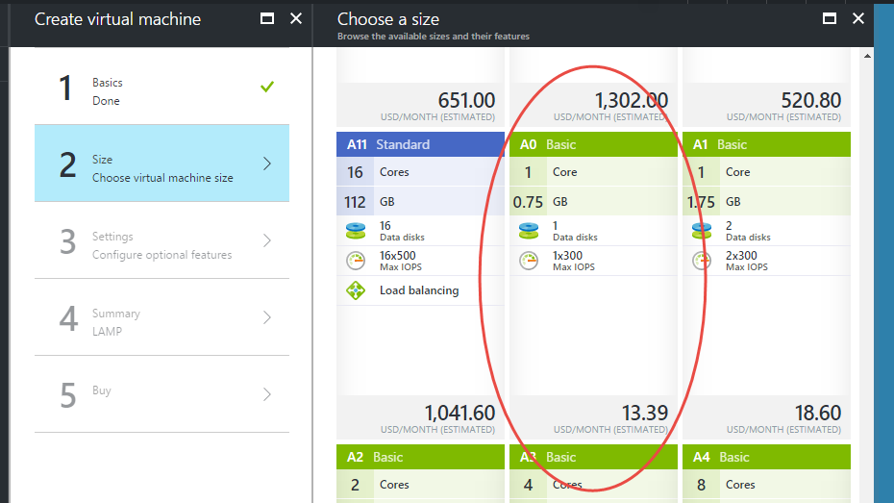
Choose the Basic size
Important: In the new Choose a size pane that opens click View all link on the far right - top of the pane. DO NOT choose one of the recommended choices that first appear. Instead, after choosing View all, scroll all the way down and click on the A0 Basic option.
Click Select.
12/1/16 Copyright Rasmussen, Inc. Proprietary and Confidential
17

Slide 18
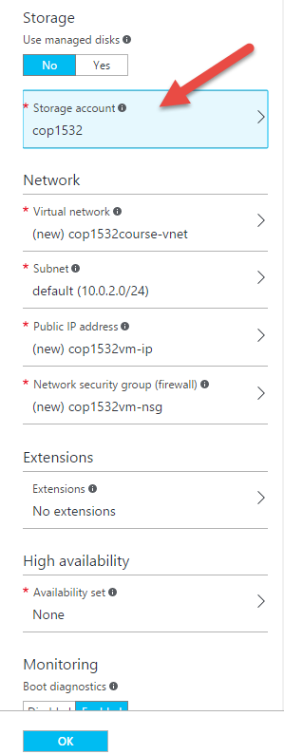
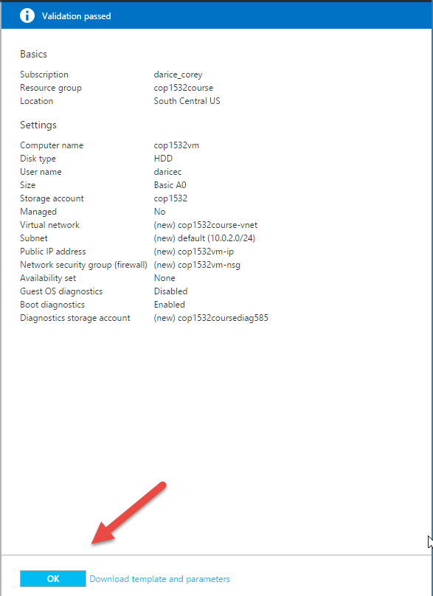
Storage Account
A new Settings pane will open.
Click on Storage account.
A Choose storage account pane will open.
Another Create storage account pane will open. DO NOT create a new storage account.
Instead, close the second pane titled “Create storage account”.
In the Choose a storage account pane, choose the storage account you created earlier.
The pane will close after choosing and you will be back at the Settings pane.
Leave the defaults for the Network settings as is.
Make sure:
Extensions is set to No extensions.
High availability is set to None.
Boot diagnostics is Enabled.
Guest OS diagnostics is Disabled.
12/1/16 Copyright Rasmussen, Inc. Proprietary and Confidential
18

Slide 19
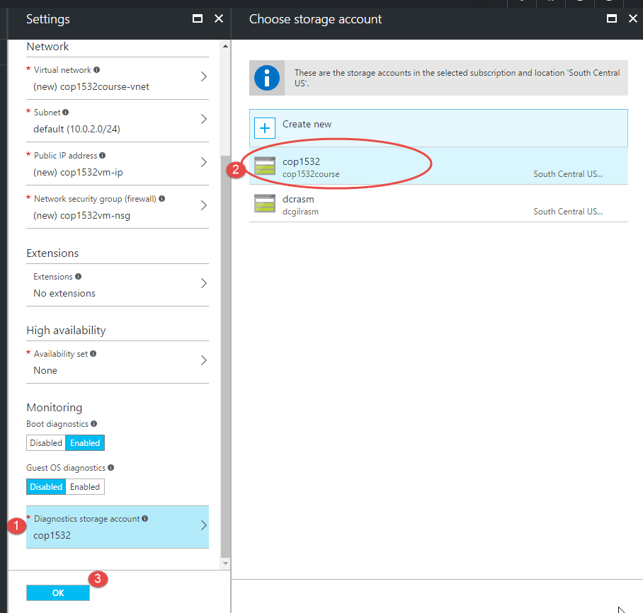
Storage Account
Click on Diagnostics storage account.
A Choose storage account pane will open.
Another Create storage account pane will open. DO NOT create a new storage account.
Instead, close the second pane titled “Create storage account”.
In the Choose a storage account pane, choose the storage account you created earlier.
Click OK at the bottom of the Settings pane.
12/1/16 Copyright Rasmussen, Inc. Proprietary and Confidential
19

Slide 20
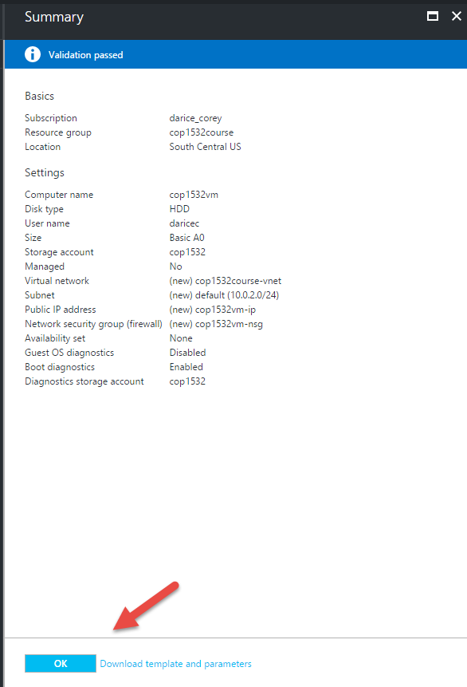
Validation Passed
A Summary pane will open.
When it says validation passed, click OK at the bottom of the pane.
A new create pane will open.
Click Create at the bottom of the pane.
12/1/16 Copyright Rasmussen, Inc. Proprietary and Confidential
20

Slide 21
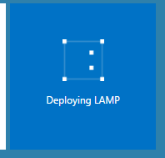
LAMP Deploying
The panes will close and your dashboard will appear with a new small deployment box for the LAMP server.
It will take a little bit for the server to be created so have patience. Do not stop the server until this lab is done because you will need to find an entry in the initial boot log near the end of this lab.
12/1/16 Copyright Rasmussen, Inc. Proprietary and Confidential
21

Slide 22
Configure the Virtual Server
Once the server is deployed a new pane for the server should open. If you took a break and it is on your Azure dashboard or in the resource group you created, find and click on the server or server box open it.
After you have opened the server administration pane, in the server administration pane there will be a number of options on the left.
Make sure Overview is selected from the options on the left.
Whenever you stop and restart the server it may acquire a new IP address. Therefore it is best to give the server a Fully Qualified Domain Name (FQDN) so you can use the FQDN to connect to the server.
12/1/16 Copyright Rasmussen, Inc. Proprietary and Confidential
22

Slide 23
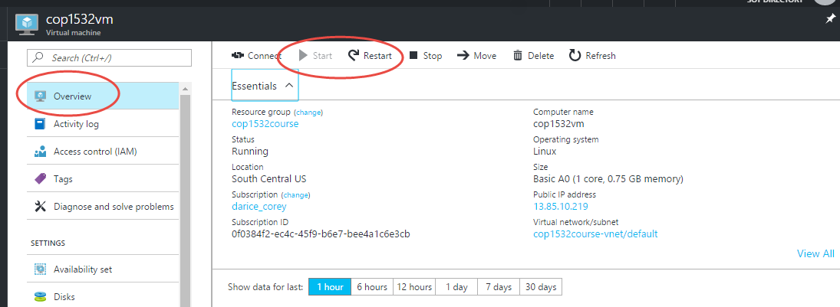
Configure the Virtual Server
12/1/16 Copyright Rasmussen, Inc. Proprietary and Confidential
23

Slide 24
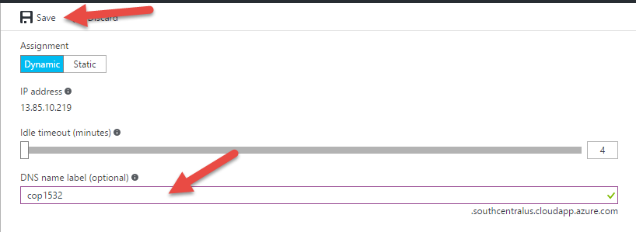
FQDN
In the right pane, click on the IP address/<none> below where it says “Public IP address/DNS name label”.
A yourservername-ip - Configuration pane will open.
To the far right, click in the text box below where it says “DNS name label (optional)”.
Type your server name, or a unique name, into the box (must be all lower case).
Click out of the box to make sure the name is accepted. It will show a green check if it is ok. If not choose a different name.
DO NOT change the IP address.
Click Save at the top.
12/1/16 Copyright Rasmussen, Inc. Proprietary and Confidential
24

Slide 25
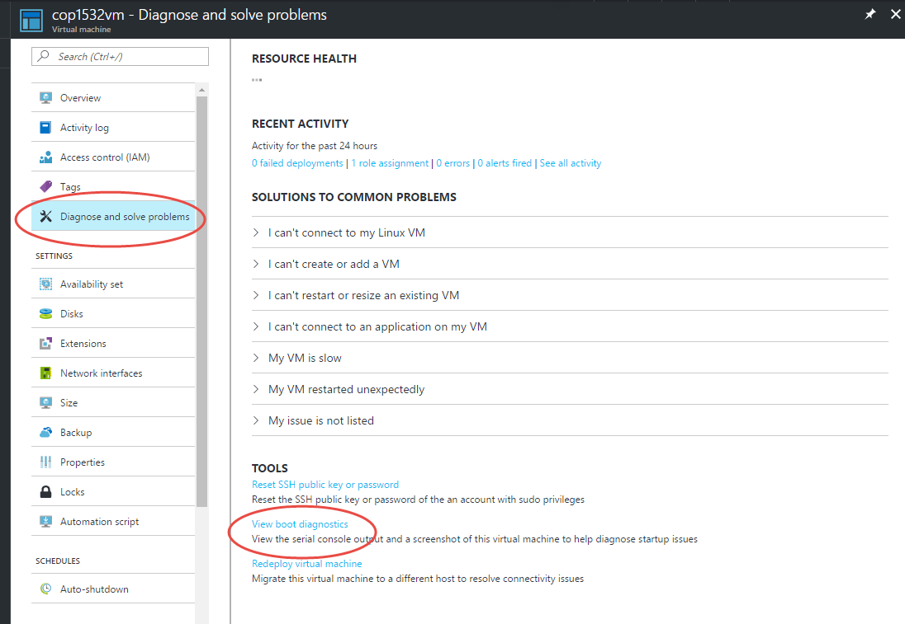
Admin pane
Copy name and suffix located below the name to the right, for later use. The suffix should be .centralus.cloudapp.azure.com or something similar. The server name you entered together with the suffix make a FQDN, e.g. exampleserver.centralus.cloudapp.azure.com. You can now connect to your server using a web browser and the FQDN.
Close the right hand IP-Configuration pane.
Because of the way that the Bitnami server installs it’s MySql database management system software, you will need to locate the MySql application password in the boot log. You will use this password later when you work with or sign in to the MySql application or its associated software that is installed on the server.
In the Server administration pane’s left hand side options, click on “Diagnose and solve problems”.
12/1/16 Copyright Rasmussen, Inc. Proprietary and Confidential
25

Slide 26
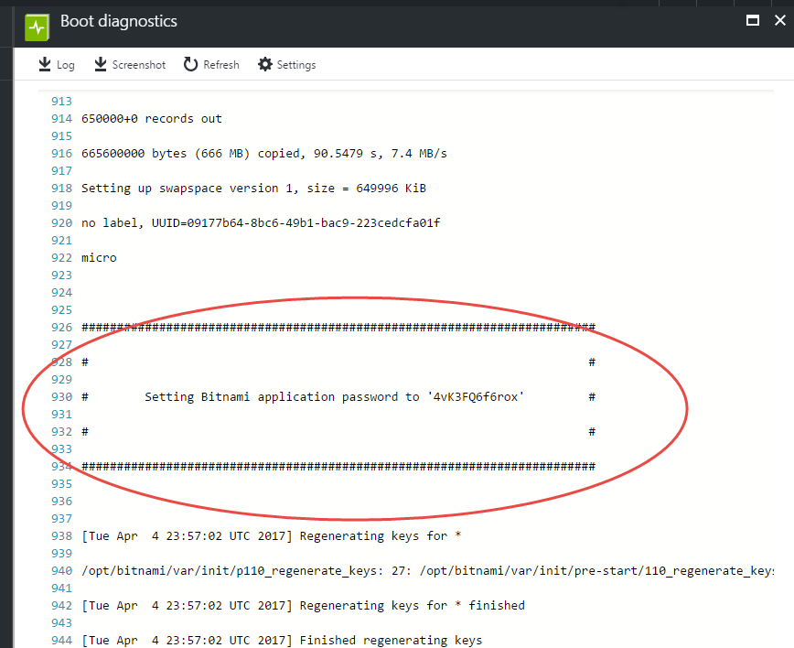
View boot diagnostics
IMPORTANT: This password is only shown the first time you start the image. Please save your password in a safe place.
When the Diagnose and solve problems pane opens on the right hand side, scroll down and click the link that says “View boot diagnostics”.
A new Boot diagnostics pane opens with a boot diagnostics file showing.
Scroll down the boot diagnostics file. You will need to scroll down quite a bit, estimated at about line 920+/-. Scroll until you see the entry that looks like this:
Setting Bitnami application password to 'ytj0Gf91FzjM'
Copy the password that shows up in your boot diagnostics file. DO NOT USE ytj0Gf91FzjM. Your application password will be different than the example above. You will need the password later. Make sure you don’t lose it.
12/1/16 Copyright Rasmussen, Inc. Proprietary and Confidential
26

Slide 27
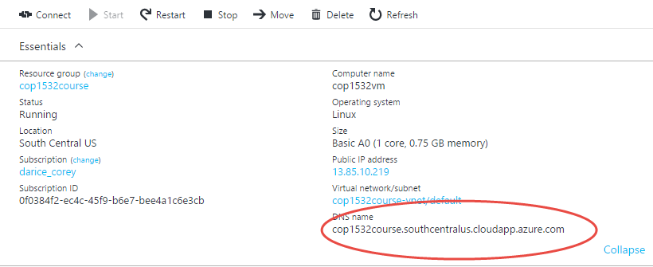
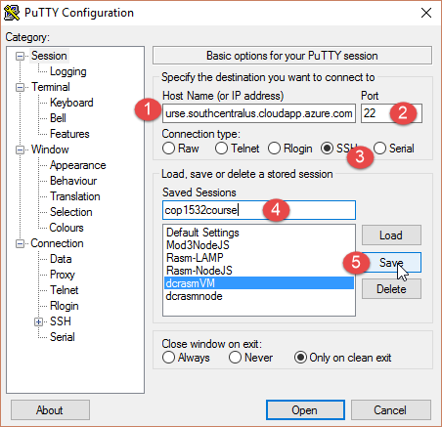
Connect to VM using Putty
For Windows:
Download putty from: http://www.chiark.greenend.org.uk/~sgtatham/putty/download.html
(Mac and Linux users will need to use their OS CLI to start a SSH session).Here are instructions: https://1drv.ms/b/s!AvJSMPv8iRDXgd08-xJ8UAkb3lXJNA
Run the putty program.
Put the FQDN for your server you saved in the host name box of putty.
Put 22 in the Port text box
Select the SSH radio button.
Under Saved Sessions type a name for this configuration setup.
Click Save.
12/1/16 Copyright Rasmussen, Inc. Proprietary and Confidential
27

Slide 28
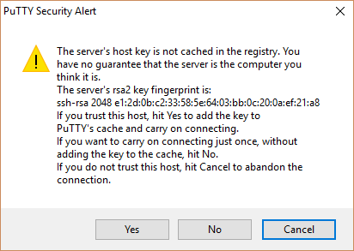
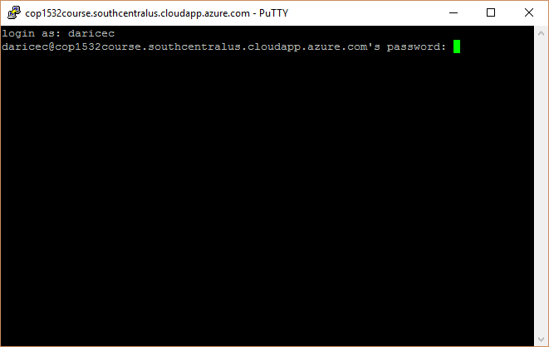
Connect to VM using Putty
(If you open putty again later, you can click on the saved session name in the list and putty will populate all the settings for you that you designated.)
Click Open.
When the Putty Security alert pops up click Yes.
When it ask, type in your LAMP server Admin name and press enter.
Type in the LAMP server Admin password and press enter. (!!! Note as you type nothing will appear. This is a security feature. What you type is there, you just cannot see it.)
You should now be successfully logged in to your server using SSH as shown below.
12/1/16 Copyright Rasmussen, Inc. Proprietary and Confidential
28

Slide 29
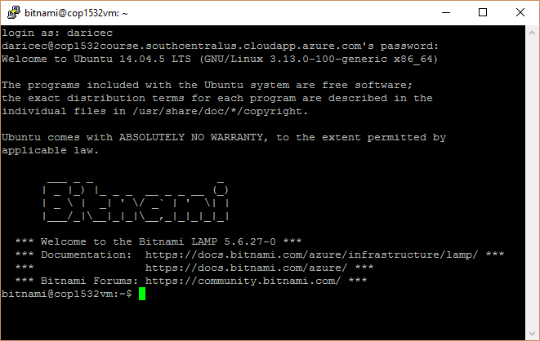
Successful Putty Connection
You should see a window with a command line that looks something like this:
12/1/16 Copyright Rasmussen, Inc. Proprietary and Confidential
29

Slide 30
OMG! Were all of those steps necessary?!
Yes! Now we have a virtual server running that is PHP enabled.
Next we will learn how to import a sample DB, as well as create a new one using phpMyAdmin.
You’ll need your Putty connection to connect to phpMyAdmin.
12/1/16 Copyright Rasmussen, Inc. Proprietary and Confidential
30

Slide 31
Database Setup
You will need:
Putty – we will need to make some changes to the settings to add a localhost connection.
Your Bitnami application password (this is DIFFERENT from the VM password that you used to connect to your server using Putty. IMPORTANT: This password is only shown the first time you start the image. Please save your password in a safe place.
Web browser – this will be used to connect to phpMyAdmin
12/1/16 Copyright Rasmussen, Inc. Proprietary and Confidential
31

Slide 32
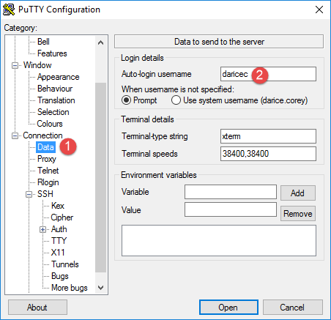
Putty
First, load the connection you saved in Putty
Let’s add a small time saver. Click on DATA. Under auto-login, enter your username. When a session is launched, it will automatically enter your username, then prompt you for your pw.
12/1/16 Copyright Rasmussen, Inc. Proprietary and Confidential
32

Slide 33
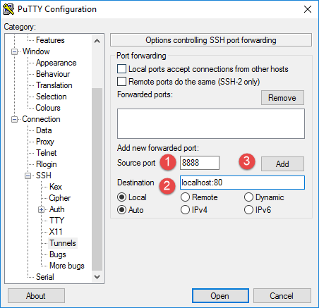
SSH >> Tunnels
Go to SSH >> Tunnels
Under source port enter ‘8888’
Under destination, enter ‘localhost:80’
Click ADD.
12/1/16 Copyright Rasmussen, Inc. Proprietary and Confidential
33

Slide 34
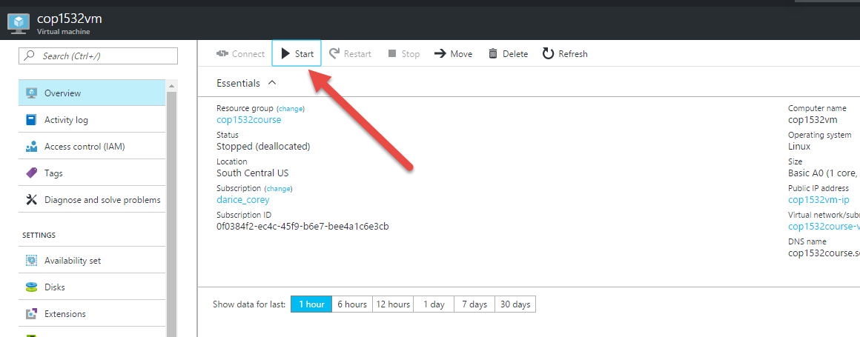
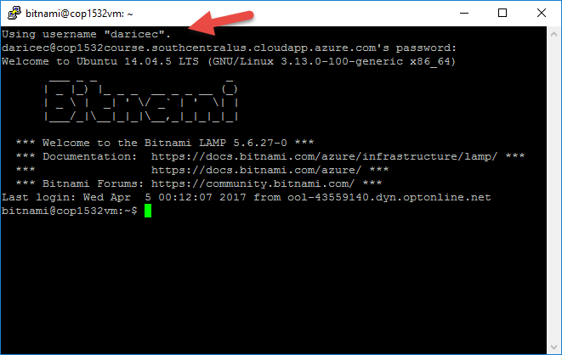
Session >> SAVE
Scroll up and click on Session >> SAVE to save your new settings.
Click on OPEN to test your configuration.
Don’t forget to START your VM on Azure. Otherwise, you will not be able to establish a connection!
12/1/16 Copyright Rasmussen, Inc. Proprietary and Confidential
34

Slide 35
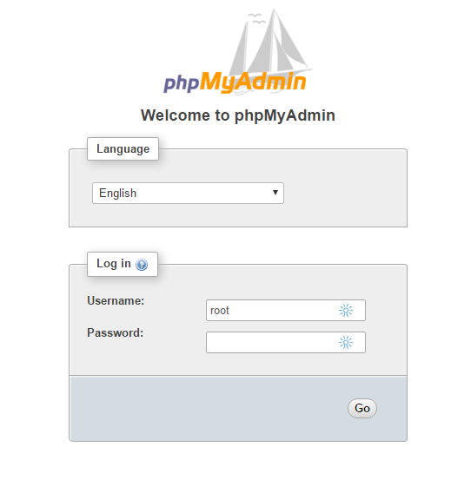
Connect to phpMyAdmin
With your Putty connection established, go to a browser and open http://localhost:8888/phpmyadmin/
Note: I noticed a bit of a delay on my VM before the connection began working. I’m not quite sure why it’s happening, but it seems to work fine if you wait a minute or so after the connection has been established.
12/1/16 Copyright Rasmussen, Inc. Proprietary and Confidential
35

Slide 36
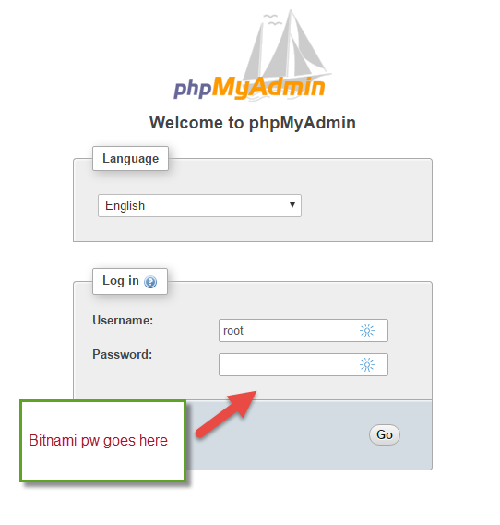
Bitnami Application Password
Remember the Bitnami application password was embedded in your boot statistics log. IMPORTANT: This password is only shown the first time you start the image. Please save your password in a safe place.
If you cannot locate this, you will need to contact the instructor asap.
12/1/16 Copyright Rasmussen, Inc. Proprietary and Confidential
36

Slide 37
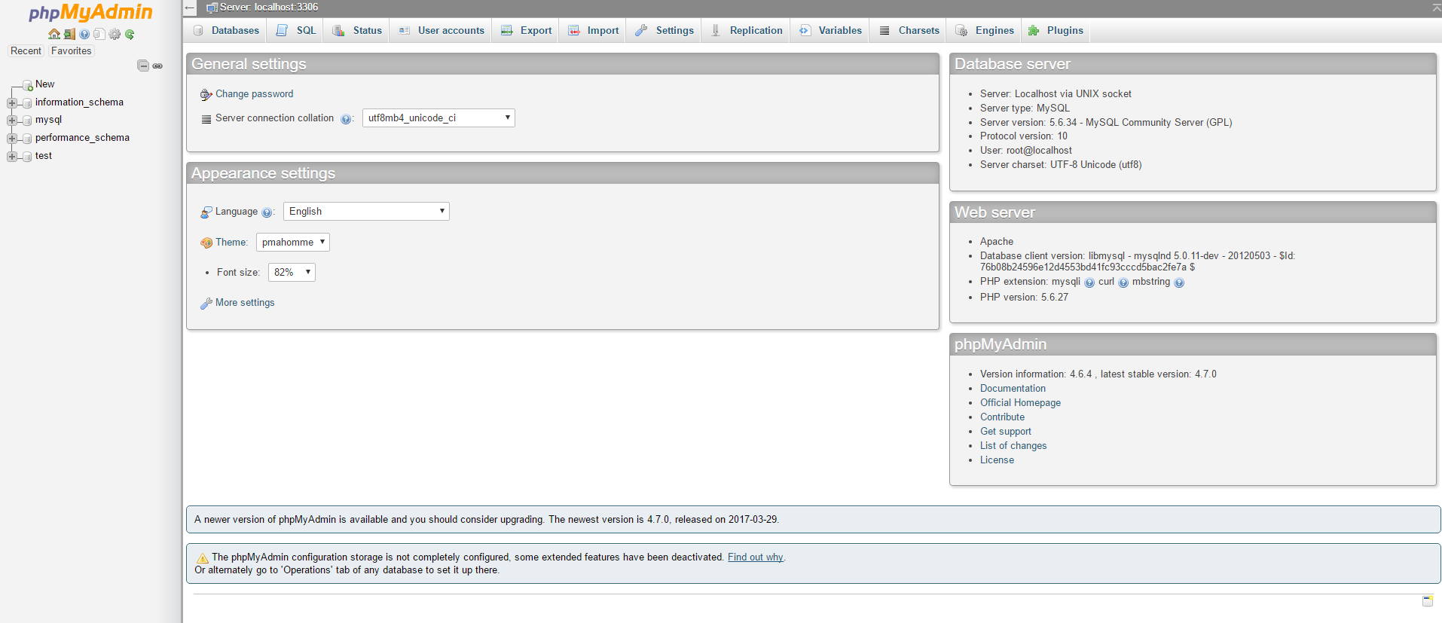
Successful phpMyAdmin login
You will see the phpMyAdmin
We will not have enough time to cover everything about phpMyAdmin.
Helpful resource:
https://www.lynda.com/MySQL-tutorials/quick-tour-phpMyAdmin/418255/441644-4.html (Did you know you have a free subscription to Lynda through Rasmussen? Click here for info.)
12/1/16 Copyright Rasmussen, Inc. Proprietary and Confidential
37

Slide 38
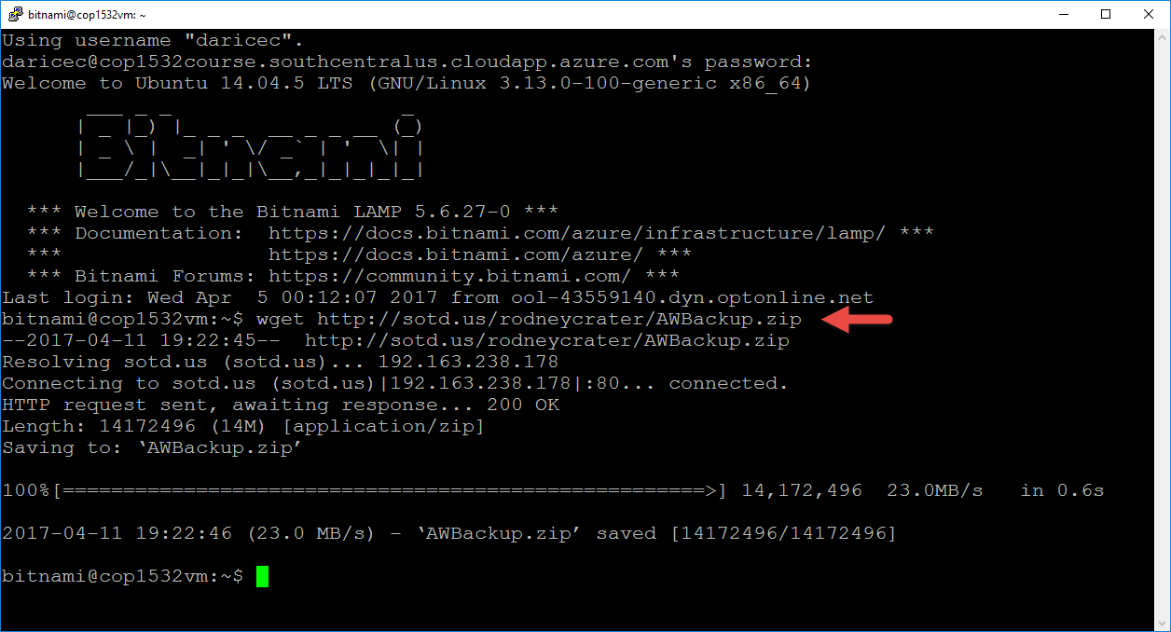
Restoring the AdventureWorks Database
Return to Putty and establish a connection to your VM if you do not have one established already.
At the command prompt type:
wget http://sotd.us/rodneycrater/AWBackup.zip
and press enter. This is going to copy a zip file from a host to your VM.
12/1/16 Copyright Rasmussen, Inc. Proprietary and Confidential
38

Slide 39
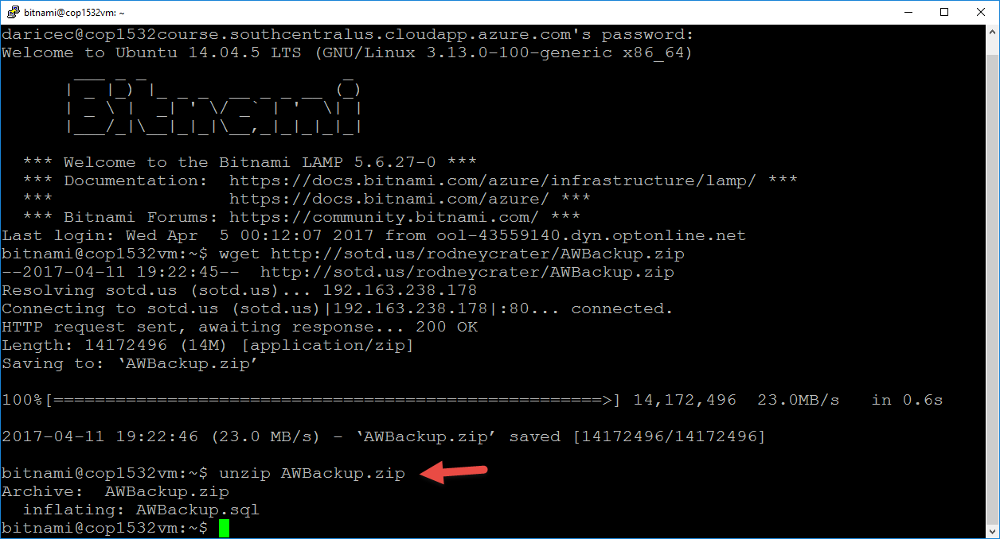
Restoring the AdventureWorks Database
Once the file is downloaded to your VM, unzip it by typing:
unzip AWBackup.zip
and press enter.
12/1/16 Copyright Rasmussen, Inc. Proprietary and Confidential
39

Slide 40
Restoring the AdventureWorks Database
Once the file is unpacked, type:
mysql -u root -p < AWBackup.sql
(note: during the live lecture I ran into an error because I typed ‘AWBackup.zip’ instead of ‘AWBackup.sql’. Try not to do that ☺)
and press enter.
You'll be prompted for a password. Use the application password that you dug out of the boot diagnostics file and saved.
**Important Note**: You will not see anything when you type the password and press ENTER.
Also, the import can take a couple minutes and it will not give you any status update. Wait for it to return to a prompt. If you’ve already waited over 5 minutes and nothing has happened, return to phpMyAdmin to see if the adventureworks db appears in the database list.
12/1/16 Copyright Rasmussen, Inc. Proprietary and Confidential
40

Slide 41
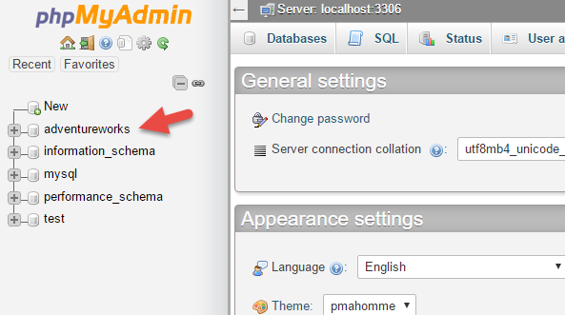
Return to phpMyAdmin
Make sure your Putty connection is still open.
Point your browser to http://localhost:8888/phpmyadmin
Log in as user root with the application password you saved.
You should see ‘adventureworks’ in your list of databases.
This concludes what is required for the Mod 2 Lab and Activity.
12/1/16 Copyright Rasmussen, Inc. Proprietary and Confidential
41

Slide 42
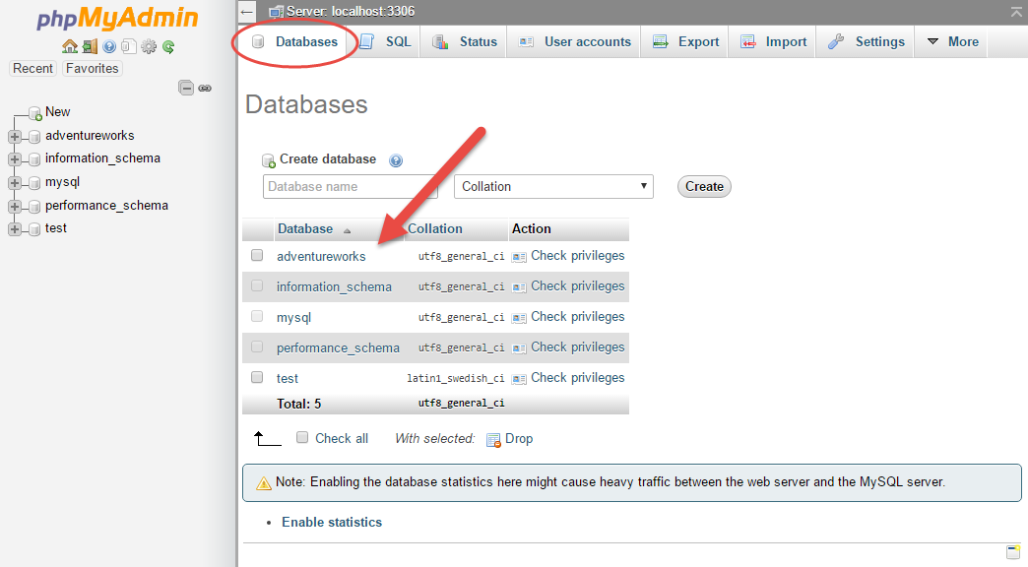
MySQL
MySQL is a relational database management system. The virtual server you created earlier in this module contains a MySQL Server, which stores databases and controls access to data. It uses SQL or Structured Query Language to allow CRUD (Create, Read, Update, Delete) operations.
MySQL uses a number of identifiers. We will cover databases, tables, columns, and indexes.
Once you log into phpMyAdmin, click on the DATABASES tab. This lists the databases residing on your VM.
12/1/16 Copyright Rasmussen, Inc. Proprietary and Confidential
42

Slide 43
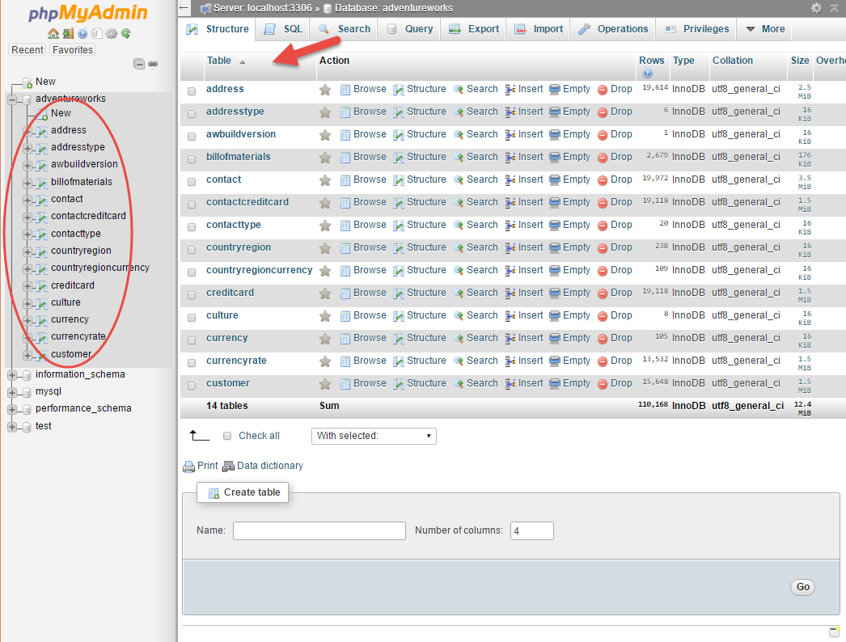
DB Structure
Click on ADVENTUREWORKS under databases.
You’ll then see a list of all the tables that are part of the adventureworks database under the STRUCTURE tab.
12/1/16 Copyright Rasmussen, Inc. Proprietary and Confidential
43

Slide 44
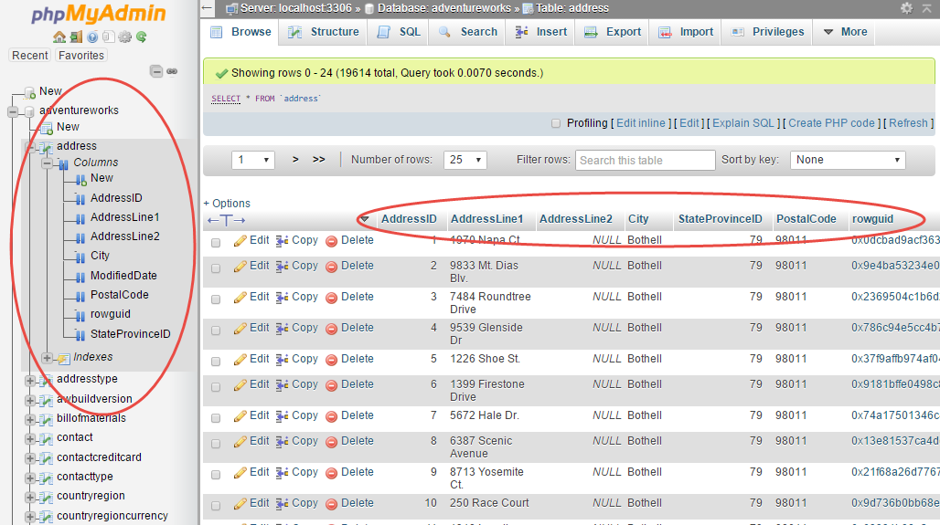
Tables: Rows
Click on the ADDRESS table. You’ll then see a list of all rows or records in the address table.
You’ll also notice the columns across the top. These columns will be used when you build your query statements and also forms.
12/1/16 Copyright Rasmussen, Inc. Proprietary and Confidential
44

Slide 45
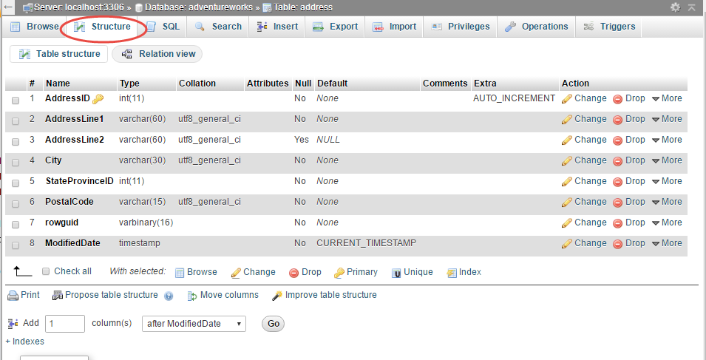
Structure
Click on the STRUCTURE tab. This allows you to view the table structure and columns. Here you’ll notice the data types and other settings can be configured.
12/1/16 Copyright Rasmussen, Inc. Proprietary and Confidential
45

Slide 46
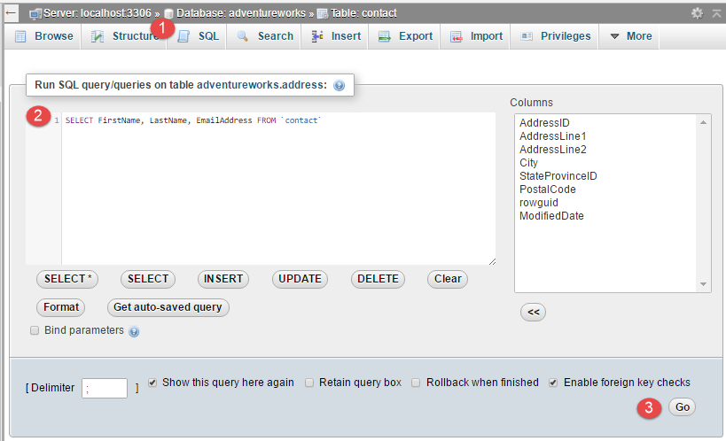
SQL
Click on the SQL tab. This will allow you to build and test queries using the database. For example, try the following SELECT statement:
SELECT FirstName, LastName, EmailAddress FROM `contact`
Then click GO.
12/1/16 Copyright Rasmussen, Inc. Proprietary and Confidential
46

Slide 47
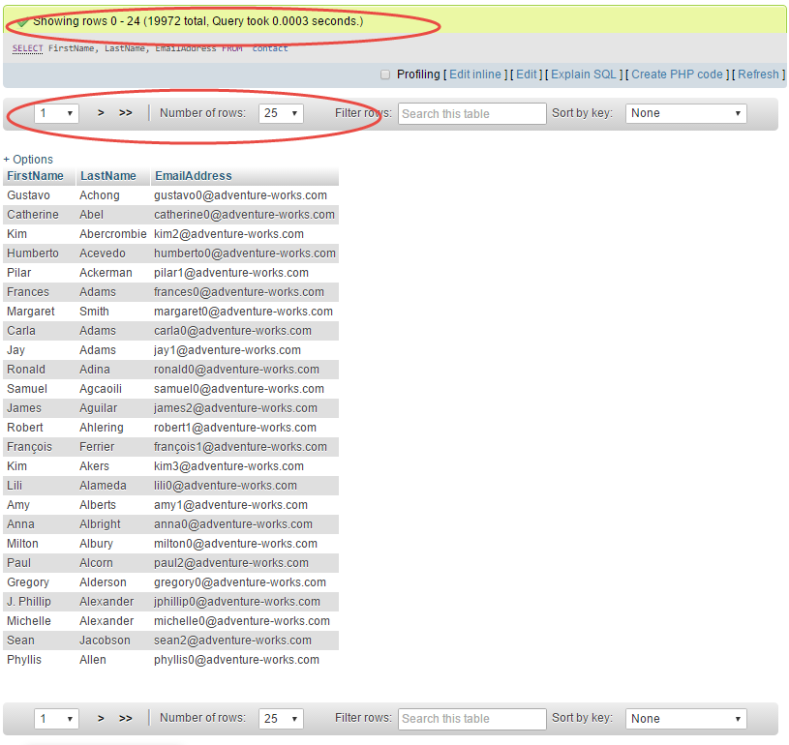
SELECT
This executes the SELECT statement and displays the results of the query.
Note that it also displays the total number of results and you can change the the number of results displayed on one page.
12/1/16 Copyright Rasmussen, Inc. Proprietary and Confidential
47

Slide 48
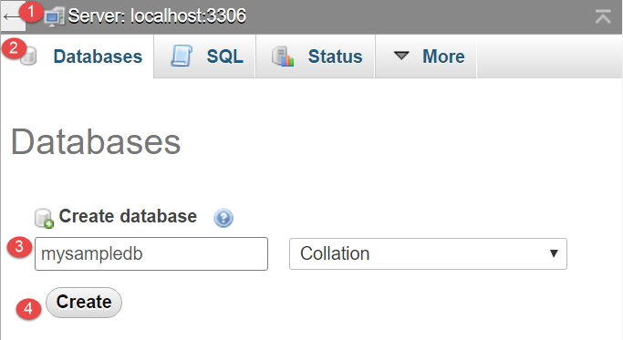
Create a Basic Sample DB
Click on the localhost across the top, then click on the DATABASES tab.
12/1/16 Copyright Rasmussen, Inc. Proprietary and Confidential
48

Slide 49
Create a Basic Sample DB
You should then see your database in the list.
Click on ‘mysampledb’, then click on the SQL tab.
Use the following SQL statement to create a table called ‘customers’.
CREATE TABLE `customers` (
`id` mediumint(8) unsigned NOT NULL auto_increment,
`fname` varchar(255) default NULL,
`lname` varchar(255) default NULL,
`address` varchar(255) default NULL,
`city` varchar(255),
`state` varchar(50) default NULL,
`zip` varchar(10) default NULL,
PRIMARY KEY (`id`)
) AUTO_INCREMENT=1;
12/1/16 Copyright Rasmussen, Inc. Proprietary and Confidential
49

Slide 50
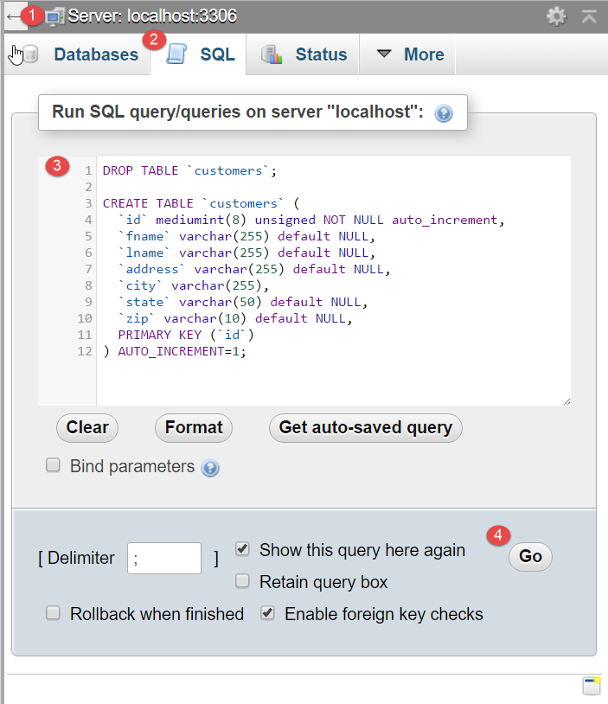
Create a Basic Sample DB
You should then see your database in the list.
Click on ‘mysampledb’, then click on the SQL tab.
Use the following SQL statement to create a table called ‘customers’.
Note: the snapshot uses a DROP TABLE statement. Do not use this for now. It will attempt to delete any table with the name ‘customers’. Since you do not currently have one, you’ll receive an error msg stating that it does not exist.
12/1/16 Copyright Rasmussen, Inc. Proprietary and Confidential
50

Slide 51
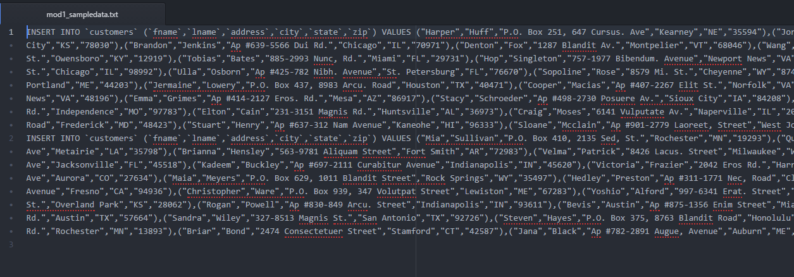
Create a Basic Sample DB
You should then have a ‘customers’ table that does not contain any data.
Click here to download sample data to insert into the ‘customers’ table. Open the file in a text editor.
12/1/16 Copyright Rasmussen, Inc. Proprietary and Confidential
51

Slide 52
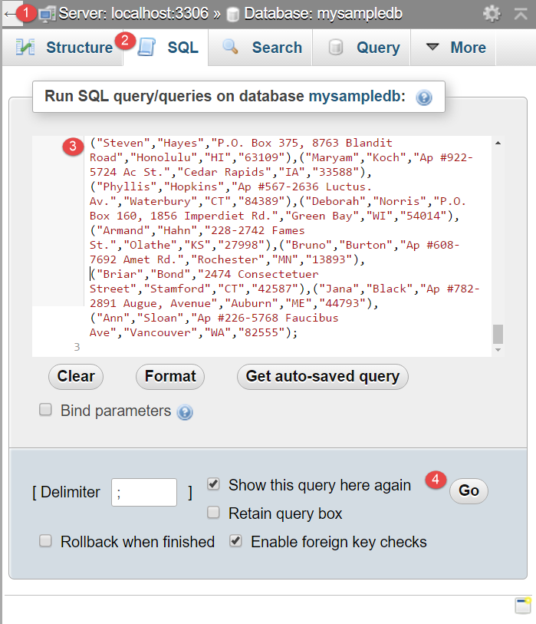
Create a Basic Sample DB
Press CTRL+A to highlight all the contents, and CTRL+C to copy.
Paste this into the SQL tab in phpMyAdmin.
Click GO.
12/1/16 Copyright Rasmussen, Inc. Proprietary and Confidential
52

Slide 53
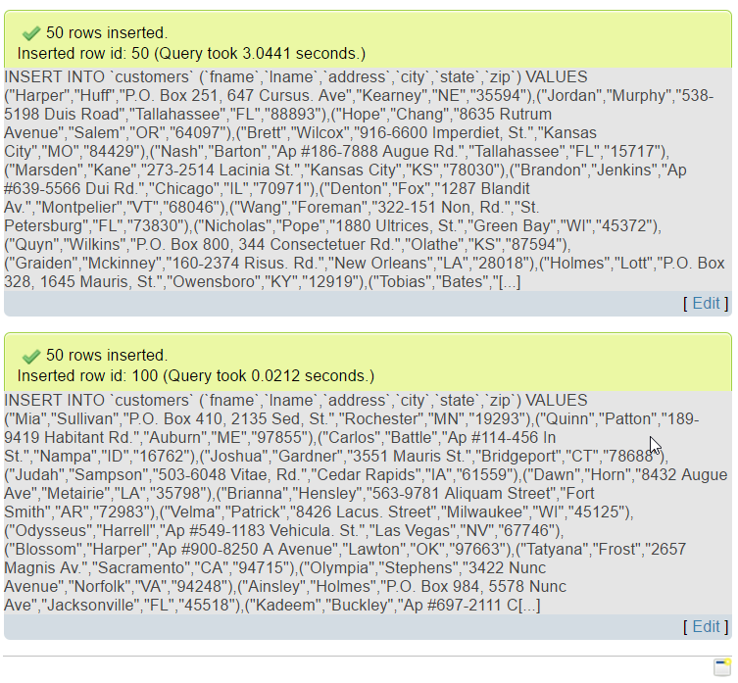
Create a Basic Sample DB
This will insert a total of 100 rows of sample data in 2 batches of 50 rows of sample data to the ‘customers’ table.
12/1/16 Copyright Rasmussen, Inc. Proprietary and Confidential
53

Slide 54
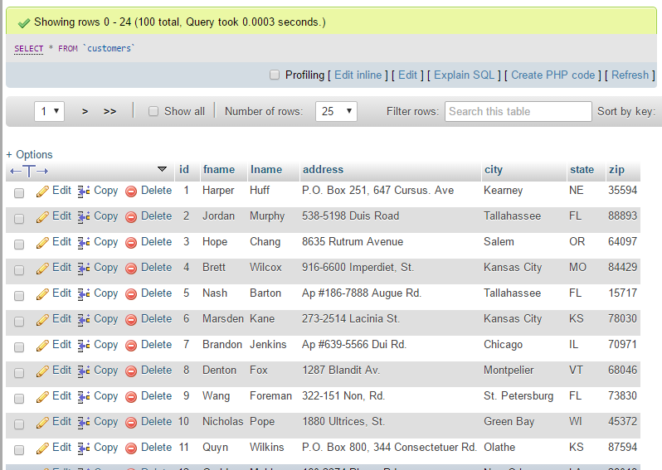
Create a Basic Sample DB
You should now be able to browse through the data you’ve just added to your sample database.
Great resource for creating sample dummy data:
GenerateData http://www.generatedata.com/
This concludes what you need to do for the mod 1 activity.
12/1/16 Copyright Rasmussen, Inc. Proprietary and Confidential
54

Slide 55
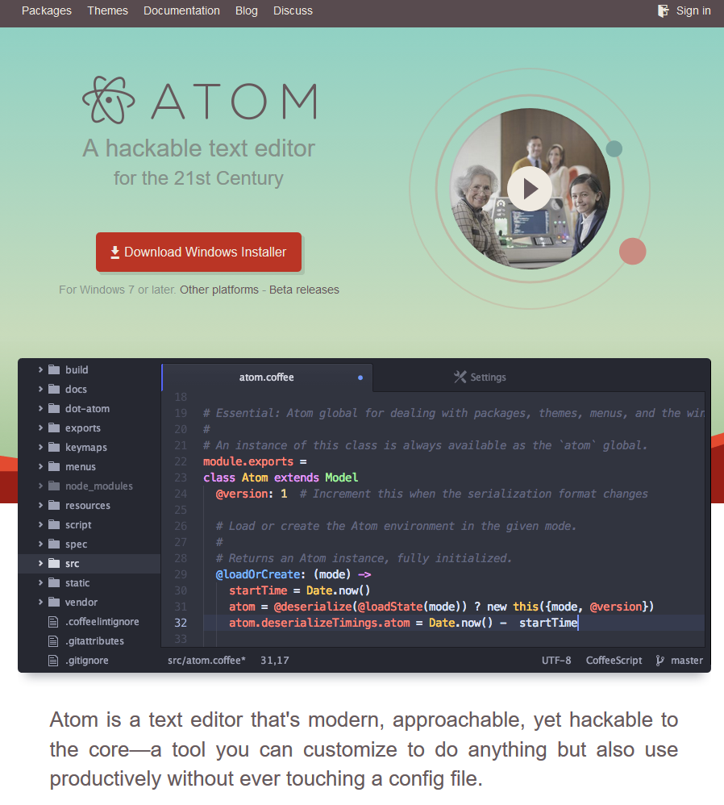
Use a text editor
Download a Text Editor
You’ll need a way to edit PHP script files.
You may use whatever you are most comfortable with. I happen to use Atom.
Download Atom, here. Use these instructions to install Atom.
12/1/16 Copyright Rasmussen, Inc. Proprietary and Confidential
55

Slide 56
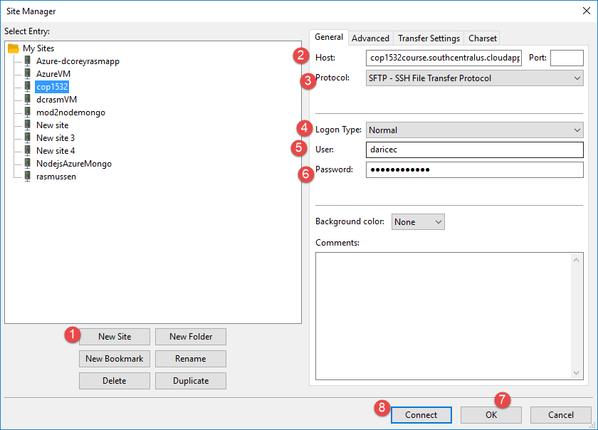
Download and Install an FTP Client
You’ll need a way to transport your PHP script files to your virtual machine. We will use FileZilla, which is a Windows and MAC compatible FTP client. You can download a copy here.
Use these instructions to install and configure Filezilla. Note: To connect you should use SFTP, and use the same login information you created to connect via Putty SSH.
12/1/16 Copyright Rasmussen, Inc. Proprietary and Confidential
56

Slide 57

Download and Install an FTP Client
While connected to your LAMP VM using Filezilla, you will need to browse to the remote folder that contains your web documents. Browse to the following path:
/opt/bitnami/apache2/htdocs
You should see your web application’s home page, ‘index.html’, a few other files, and the ‘img’ folder.
Now, you may copy the module 1 sample code to the ‘htdocs’ folder on your remote site.
**Important note**: Make sure that when you copy this file to the htdocs folder, you rename it as ‘index.html’. Webservers look for default documents as homepages such as “index.php” or “index.html”, or “default.html” or “default.php”. Otherwise, you need to browse to a specific URL to view your page, like http://[VM name}.centralus.cloudapp.azure.com/[filename]
12/1/16 Copyright Rasmussen, Inc. Proprietary and Confidential
57

Slide 58

Browse to the page
Now, browse to that page using your web browser. Use the FQDN + ‘/’ + the filename. For example:
http://[YOUR VM NAME].southcentralus.cloudapp.azure.com/index.html Or http://[YOUR VM NAME].southcentralus.cloudapp.azure.com/mod1_ex1.html
You should see the page you just copied (mod1_activity.html).
12/1/16 Copyright Rasmussen, Inc. Proprietary and Confidential
58

Slide 59



Create a GitHub account
Create a username and pw.
You can also sign up for a student account here:
https://education.github.com/
Make sure you use your Rasmussen.edu email address!

Slide 60

Step 3: Join a GitHub Classroom (if advised by your instructor)
If instructed, join a classroom using the classroom invitation link provided by your instructor. This is provided on the Live Lecture Presentation and Recordings page.
You'll be prompted to authorize GitHub Classroom.
Click to accept the assignment.

Slide 61

Repository creation
This will automatically generate a repository for the assignment link provided by your instructor.

Slide 62

Repository creation
From here, you need to generate a README to clone the repository to your desktop.

Slide 63

Download GitHub for Desktop
https://desktop.github.com/

Slide 64


Configure the software to connect to your GitHub account
https://help.github.com/desktop/guides/getting-started-with-github-desktop/authenticating-to-github/
Go to File >> Options >> Accounts

Slide 65


Clone your repository to your desktop
Click on CLONEOR DOWNLOAD
Select OPEN IN DESKTOP
This will launch GitHub Desktop.
It will confirm where you want to store your local copy. Select one and click OK.
If you create a new folder, you’ll need to copy your existing web files to this folder.

Slide 66

Open up the repository in GitHub desktop
If you modify any files locally, you should see them listed as ‘Changes’
Click on your repository
You’ll see any modified or new files listed with checkmarks next to them.
Enter a summary of your change and a description.
Click on COMMIT TO MASTER

Slide 67

Created commit…
You’ll see a message across the lower left stating ‘Created commit’ plus your summary.
Now click on SYNC in the upper right.
This will push your changes or new files to your GitHub repository on GitHub.com.

Slide 68

Go to GitHub to confirm the ‘push’
You should see the updates or new files under the CODE tab.

Slide 69
Now, anytime you update your files locally…
The steps should be:
Update files locally.
Commit and sync with GitHub.
Use FTP to upload your web files to your Azure VM.
Your site will then be updated!

Slide 70


If you’re using a local editor such as Atom.io…
Simply add your local git folder as a project folder

Slide 71

You can also git on Atom to push changes to GitHub directly from Atom (and save an extra step)
Go to PACKAGES >> GitHub >> Git Tab

Slide 72

Now you can commit and push from Atom
Stage your changes – select files that will be pushed to your repo.
Type your commit message
Click Commit
Push changes by clicking arrows on the lower right.

Slide 73

Your updated files should now appear in GitHub
You can test this by either connecting to your Azure site via FTP or try browsing to the page by adding it to the URL.

Slide 74

To view updates or history…
You can view the changes in GitHub Desktop

Slide 75
To view updates or history…
Or click on the file on GitHub, then click on HISTORY

Slide 76

To add a collaborator (such as the instructor)
Go to your repository, click on Settings >> Collaborator
Type in the username. Mine is ‘dcoreyrasm’

Slide 77
Module 1 Activity Screenshots
Include snapshots of:
Azure VM setup. One snapshot showing the Overview screen is fine.
Configuring Putty – autologin and localhost
All steps to import the adventureworks db.
Snapshot of adventureworks in phpMyAdmin by browsing to localhost:8888/phpmyadmin
Configuring Filezilla
snapshot of site manager connection
remote site folder list
copied files to htdocs folder.
Atom – show list of web folders (module 1, module 2, module 3, etc. with activity and project folders.
GitHub Desktop or Atom connected to git
Hello World! Web page loaded in browser
12/1/16 Copyright Rasmussen, Inc. Proprietary and Confidential
77

Slide 78

Module 01 Activity Rubrics

Slide 79

Module 1 Course Project
Using any website mockup tool, create a website mockup of the homepage for your project. There are many wireframing tools available for free online or by download. You may mockup using:
Microsoft Word or PowerPoint
Microsoft Visio (Available on http://rasmussen.onthehub.com )
Other tools such as https://wireframe.cc/
Here is an example of one page of a mockup (Note: This is only an example. You should research best practices on layout and content for web applications and create an original design.)
12/1/16 Copyright Rasmussen, Inc. Proprietary and Confidential
79

Slide 80

Module 1 Course Project Rubrics
12/1/16 Copyright Rasmussen, Inc. Proprietary and Confidential
80

Slide 81
Office Hours
Please email or post your questions in the General Questions Forum in advance. This helps me prepare, so we don’t use up time pulling up screens, logging in, etc.
12/1/16 Copyright Rasmussen, Inc. Proprietary and Confidential
81

Slide 82
Live Lecture Keyword…
Don’t forget to enter this in the live lecture quiz to get credit for attending!
If you run into issues, please post question in the general questions forum.
When posting issues or emailing me for help, it is helpful to include screenshots as well as a description of what you were doing when it occurred. Also, include any error messages.
Have a great week!
12/1/16 Copyright Rasmussen, Inc. Proprietary and Confidential
82

Slide 83
The keyword is…
…

Slide 84
Additional Resources
Bitnami LAMP on Azure https://docs.bitnami.com/azure/infrastructure/lamp/
Bitnami pw https://docs.bitnami.com/azure/faq/#using-the-azure-marketplace
Bitnami/Putty connection https://docs.bitnami.com/azure/faq/#obtaining-your-ssh-credentials-from-the-bitnami-launchpad
Bitnami LAMP on Azure – Accessing PHPMYADMIN https://docs.bitnami.com/azure/infrastructure/lamp/#access_phpmyadmin

